Slide 1
Web3 Introduction
Web3 Development for Beginners

Slide 2
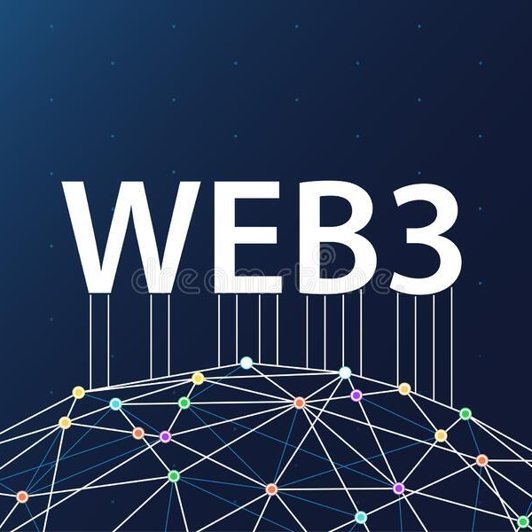
What is web3?
Let’s go back in history: What is web1?
Text & Information provided to you
Okay, then: web2
User Generated Content
Social Media
So, what then is web3?
User owned content
Decentralized controls
Less dependence on big players
And web2.5?
The in-between

Slide 3
How does blockchain fit into this?
Web3 does not inherently dictate blockchain use
Blockchain is a great fit though
Roblox: Web3 or not?
Decentral: Blessing or curse?

Slide 4
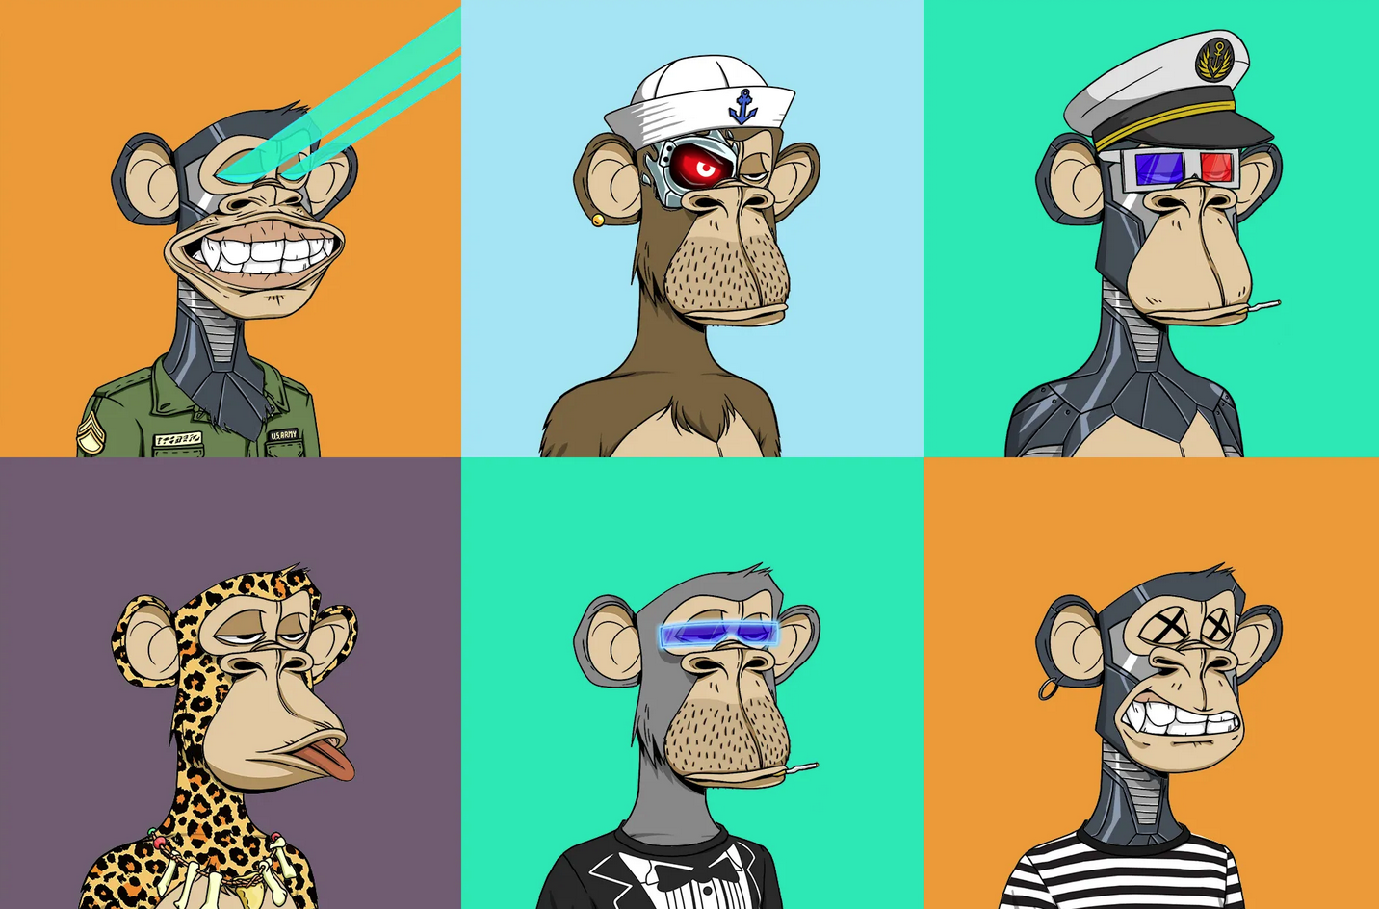
Current State of web3
Tokens
NFTs & Cryptotokens
Decentralized Finance (DeFi)
Liquidity Pools
Staking
Loans & Funding
Decentralized Governance
Decentralized Autonomous Organizations (DAOs)
Voting
Global

Slide 5
Projects to know
Incomplete but a start:
Uniswap (Decentralized Trading)
OpenSea (NFT Marketplace)
Twitter (Community & News)
Coinbase, Binance, Kraken (Centralized Exchanges)
Metamask (Wallet)

Slide 6
Recap
Web3 already exists
Web3 is different from web2 in the following ways:
Decentral aspects
Global
Web3 refuses reliance on traditional infrastructure providers as far as possible
You need to know some terms for web

